Slide 1
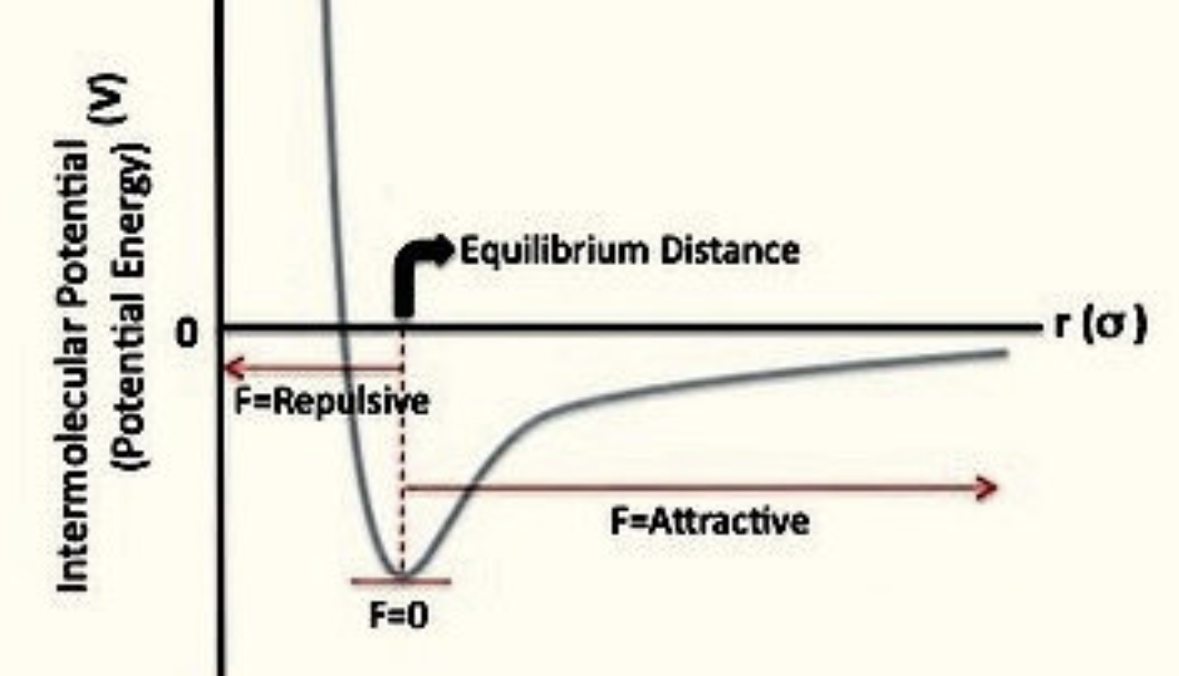
Recap: Interpreting the behavior of $U$ in the volume direction
Here’s what a typical potential energy curve looks like between two real atoms; we called this “stickiness” before.
Intermolecular attractions must be overcome when increasing the volume

Slide 2
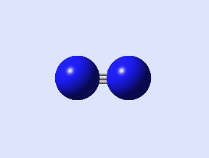
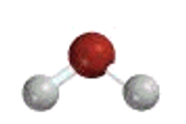





We also predicted these heat capacities
$$C_{V}=$$
$$C_{V}=$$
Low-temperature limit
High-temperature limit
$$C_{V}=$$
High-temperature limit
$$C_{V}=$$
$$C_{V}=$$
Low-temperature limit
High-temperature limit

Slide 3

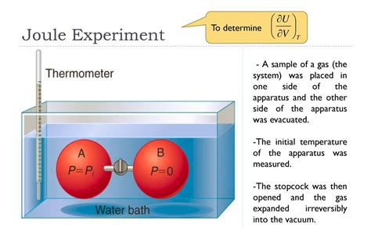
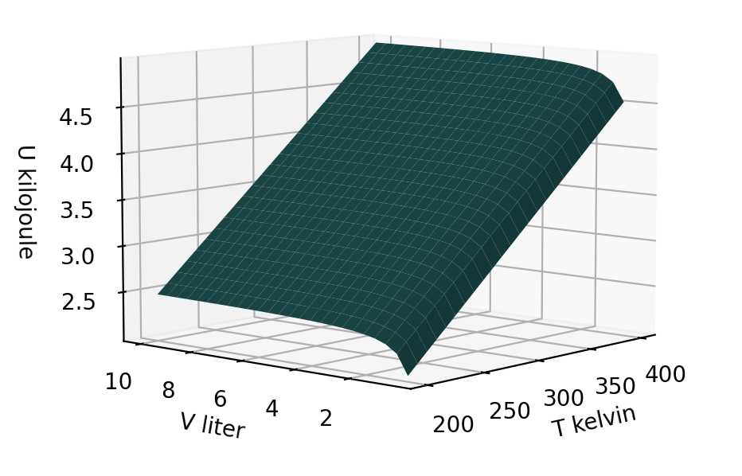
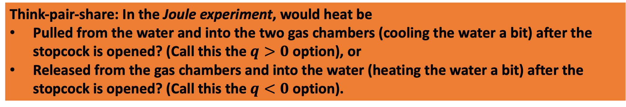
Think-pair-share: In the Joule experiment, would heat be
Pulled from the water and into the two gas chambers (cooling the water a bit) after the stopcock is opened? (Call this the $q>0$ option), or
Released from the gas chambers and into the water (heating the water a bit) after the stopcock is opened? (Call this the $q<0$ option).

Slide 4
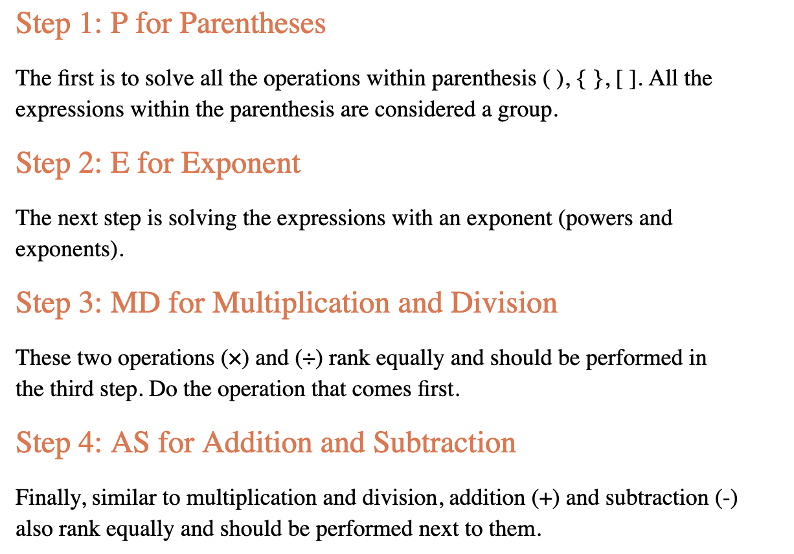
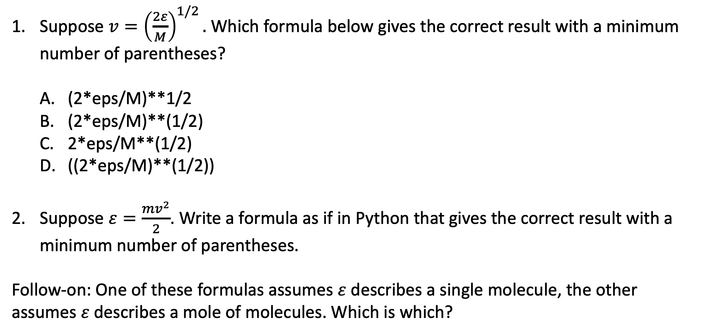
Blackboard challenge #1: Order of operations
Suppose $v={\left(\frac{2ε}{M}\right)}^{1/2}.$ Which formula below gives the correct result with a minimum number of parentheses?
(2*eps/M)**1/2
(2*eps/M)**(1/2)
2*eps/M**(1/2)
((2*eps/M)**(1/2))
Suppose $ε=\frac{mv^{2}}{2}$. Write a formula as if in Python that gives the correct result with a minimum number of parentheses.
Follow-on: One of these formulas assumes $ε$ describes a single molecule, the other assumes $ε$ describes a mole of molecules. Which is which?
Notes:
Week 1

Slide 5
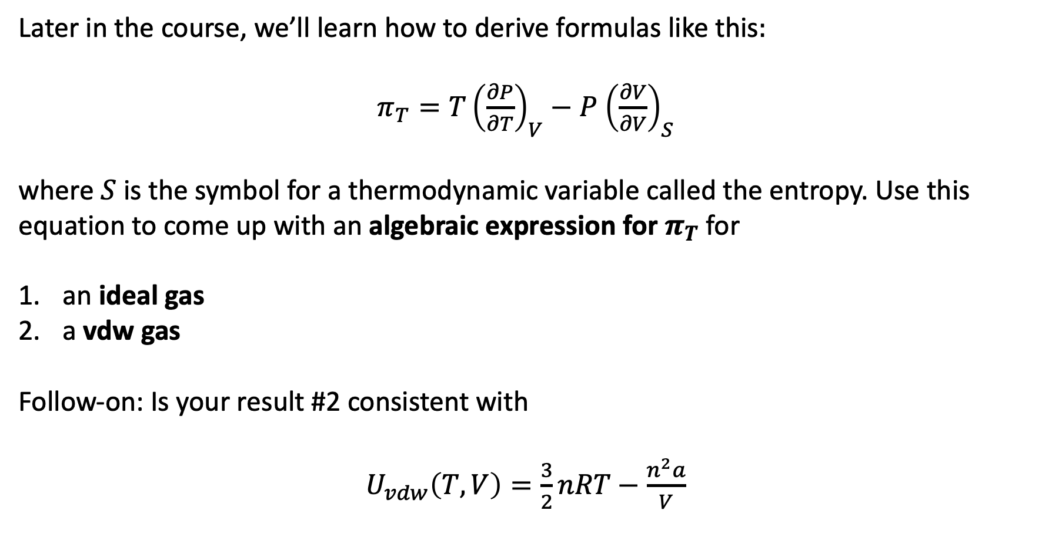
Blackboard challenge #2: Derivation of $π_{T}$
Later in the course, we’ll learn how to derive formulas like this$:$
$π_{T}=T{\left(\frac{∂P}{∂T}\right)}_{V}−P$ ${\left(\frac{∂V}{∂V}\right)}_{S}$
where $S$ is the symbol for a thermodynamic variable called the entropy. Use this equation to come up with an algebraic expression for $π_{T}$ for
an ideal gas
a vdw gas
Follow-on: Is your result #2 consistent with
$U_{vdw}\left(T,V\right)=\frac{3}{2}nRT−\frac{n^{2}a}{V}$

